Slide 1
Angad
Malware Detection via
Multi-Dimensional Visualization
Ankur Tyagi (@7h3rAm)

Slide 2
whoami
Sr. Malware Research Engineer @ Qualys
@7h3rAm on the Interweb

Slide 3

Outline
Issues with Malware Analysis
What is Multi-Dimensional Visualization?
Context-aware Multi-Dimensional Visualization
Usecases
@7h3rAm

Slide 4
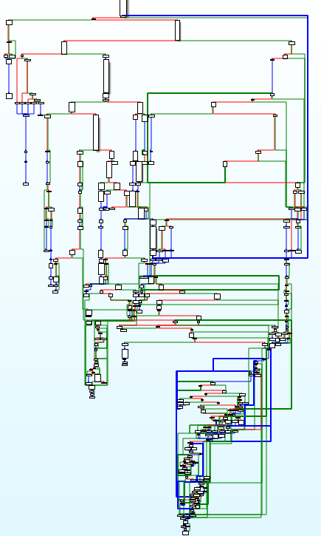
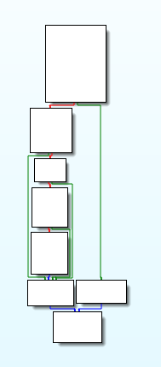
Issues with Malware Analysis
Nymaim obfuscation and cyber variant of "knock, knock, who’s there?“ (@Avira)
Nymaim (is a trojan, downloads additional malware) CFGs
pre deobfuscation (#1): 200+ blocks
post deobfuscation (#2): 8 blocks
1
2
@7h3rAm

Slide 5
Issues with Malware Analysis
Malware Analysis is difficult:
Obfuscation, anti-* (disassembly, debugging, virtualization)
Volume of new unknowns is huge (250k+ unknowns daily, 90%+ clean)
Lots of interesting proposals to solve these issues over last many years
Vendors use proprietary (closed/IP-protected) solutions
Enthusiasts build and use “personal” projects (difficult to gain traction)
@7h3rAm

Slide 6
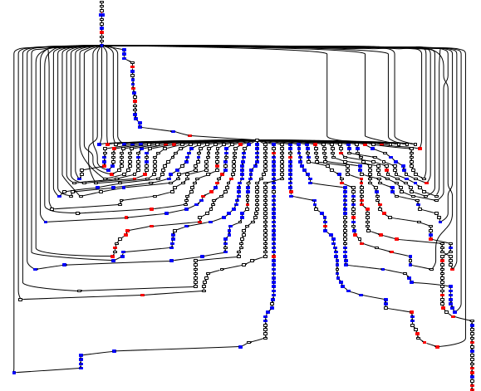
Issues with Malware Analysis
What Does Obfuscated Software Look Like? (The University of Arizona)
Issues with current automated techniques:
packers/virtualizers/compressors (themida, vmpack, aspack)
runtime dependencies
trigger conditions
sandbox detection
user interaction
@7h3rAm

Slide 7
Issues with Malware Analysis
We need to focus on generic signatures to reduce overhead and increase future coverage
Note: Excessive generalization in detection methods can increase FPs
We still need specialized detection methods for threat attribution
@7h3rAm

Slide 8
Issues with Malware Analysis
Lots of interesting research has been done towards applying visualization techniques for malware analysis
Malware Analysis Using Visualized Image Matrices (Han et al.)
Malware Images: Visualization and Automatic Classification (Nataraj et al.)
Visual Analysis of Malware Behaviour Using Treemaps and Thread Graphs (Holz et al.)
and many more ...
@7h3rAm

Slide 9
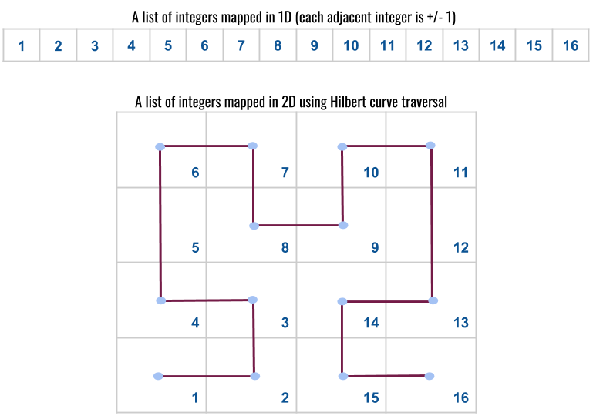
What is Multi-Dimensional Visualization?
A Hilbert curve is a continuous fractal space-filling curve
Recursive, self-similar, space-filling
Fills a square area using Gray code traversal
Unit dimension is 2, images are always a square
@7h3rAm

Slide 10
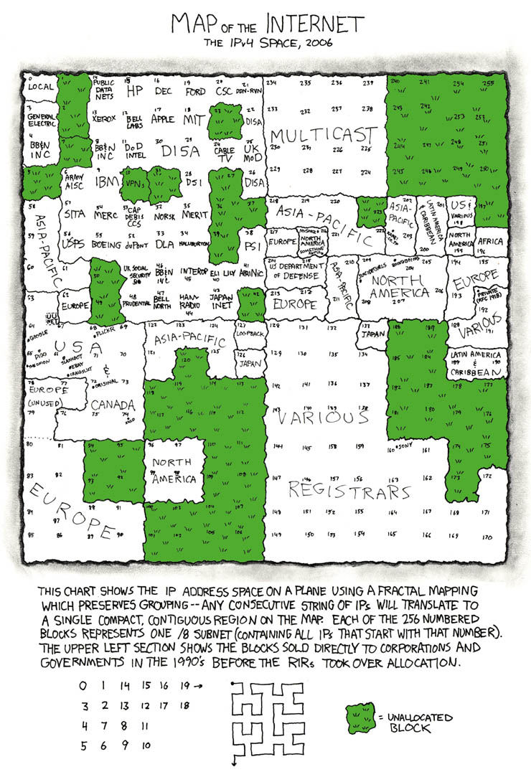
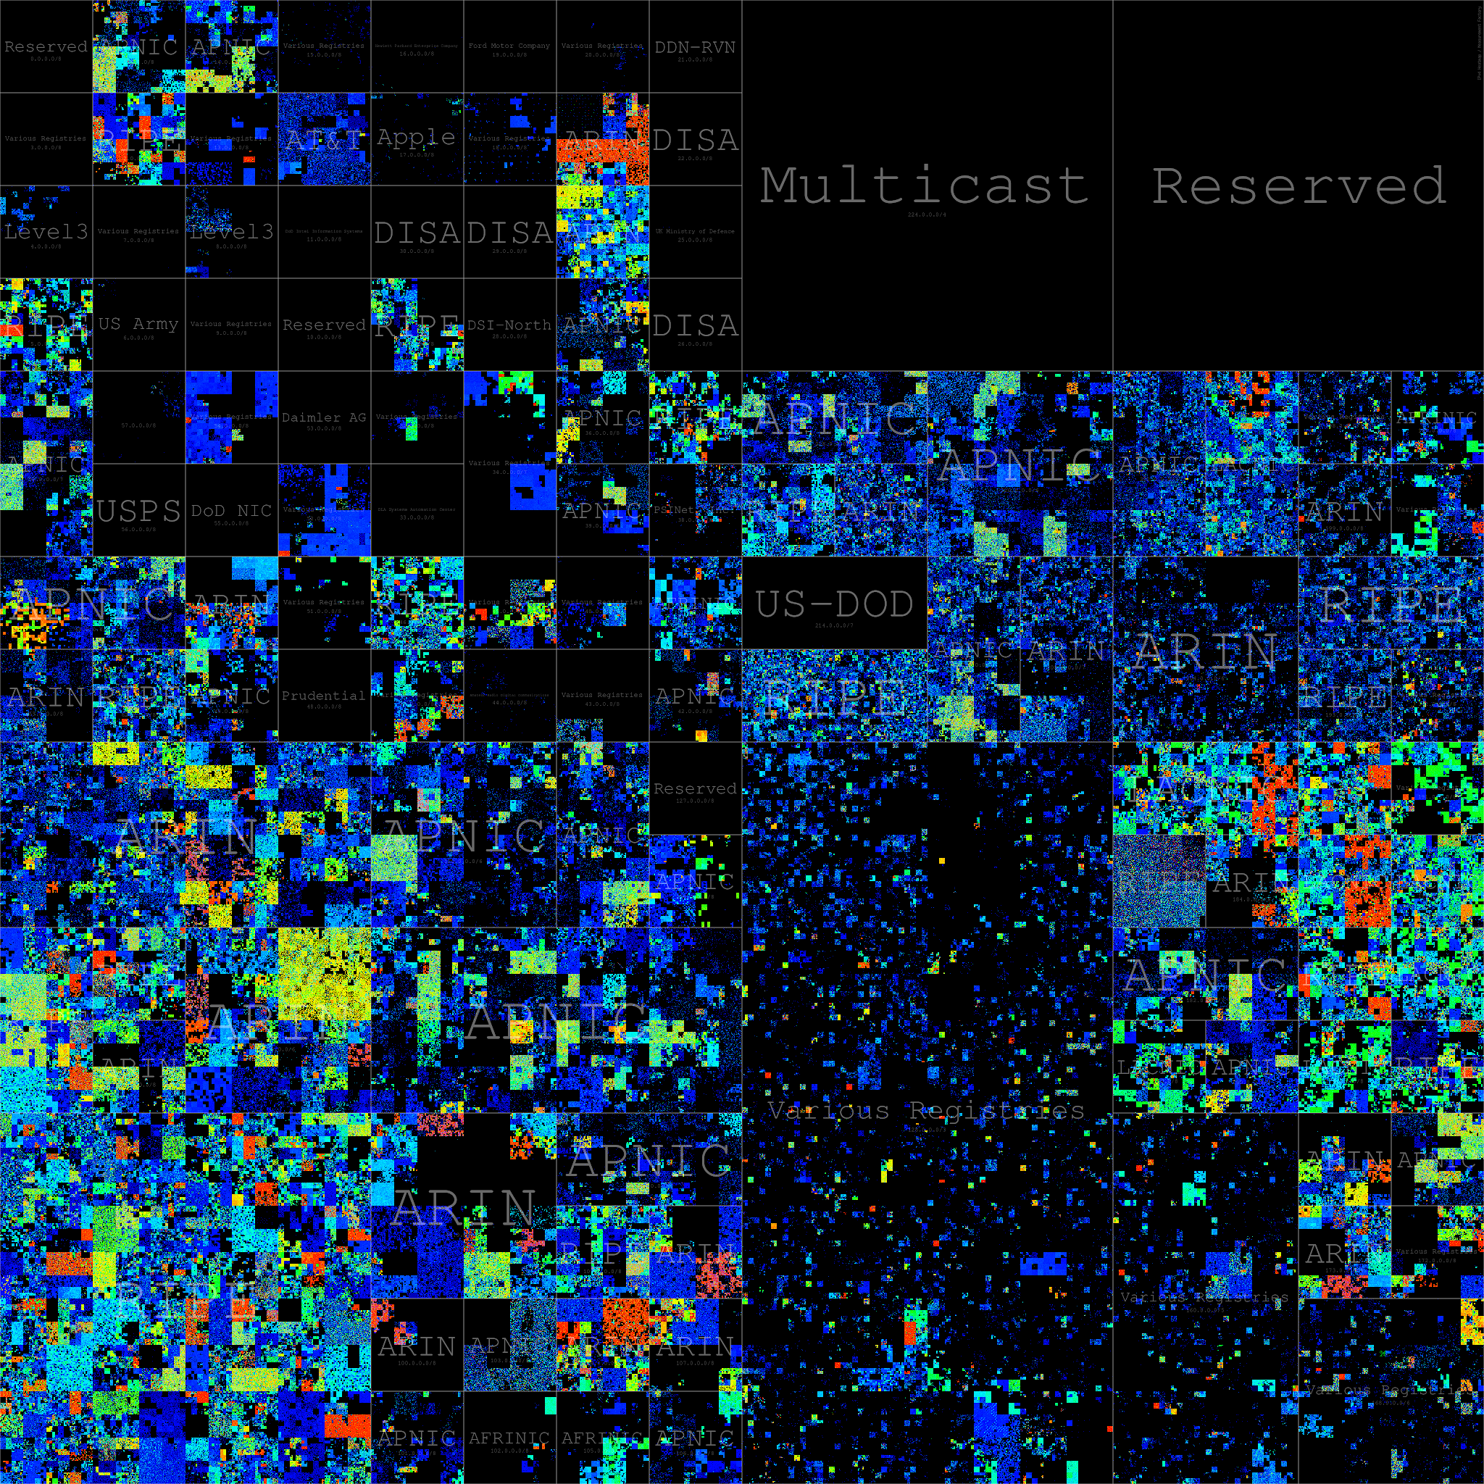
What is Multi-Dimensional Visualization?
xkcd 195: Map of the Internet
Mapping the whole Internet with Hilbert curves (@benjojo12)
IPv4: 2^32 ~= 4+ billion addresses
@7h3rAm

Slide 11
What is Multi-Dimensional Visualization?
Important characteristics:
Clustering (locality preserving in 2D)
Spatial indexing
Can be indexed and matched against unknown input for clustering and classification
Can be used as a visual hash (contrast with cryptographic hashes)
@7h3rAm

Slide 12
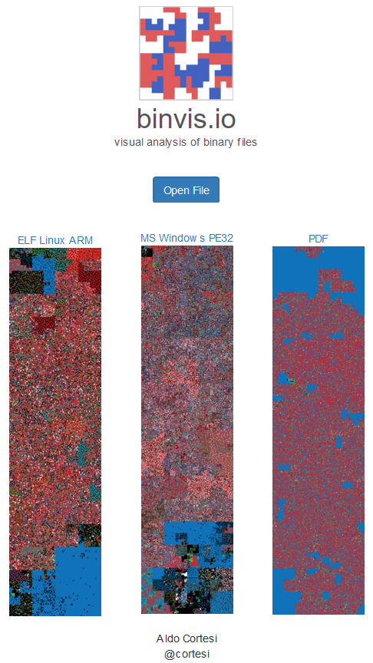
What is Multi-Dimensional Visualization?
Let’s discuss how to use Hilbert curves to visualize malware structure and APIs
Aldo Cortesi (@cortesi) has posted about this in depth on his blog
Check out his project binvis.io for more details
@7h3rAm

Slide 13
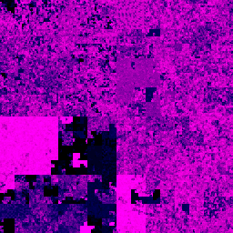


What is Multi-Dimensional Visualization?
Hilbert curves created using scurve library from @cortesi
All files have unique hashes but (structurally) similar Hilbert curve representations
@7h3rAm

Slide 14
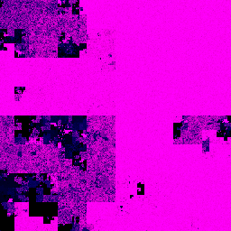
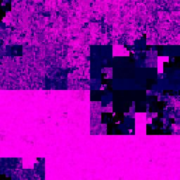
What is Multi-Dimensional Visualization?
Difficult to identify offsets for prominent structures
Unable to retain shape for similar content at different offsets
@7h3rAm

Slide 15
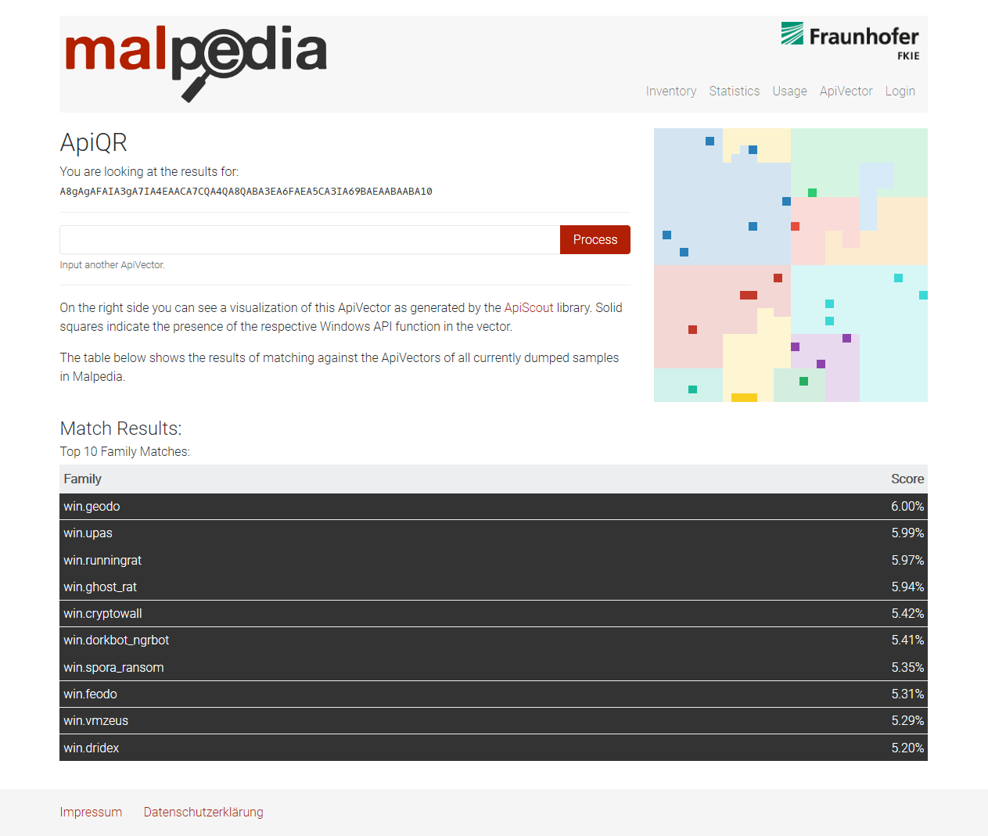
Context-aware Multi-Dimensional Visualization
Daniel Plohmann has used Hilbert curve to visualize import APIs
Check out the Malpedia service to see how imported APIs from PE files are used to create a visual hash (ApiQR)
@7h3rAm

Slide 16
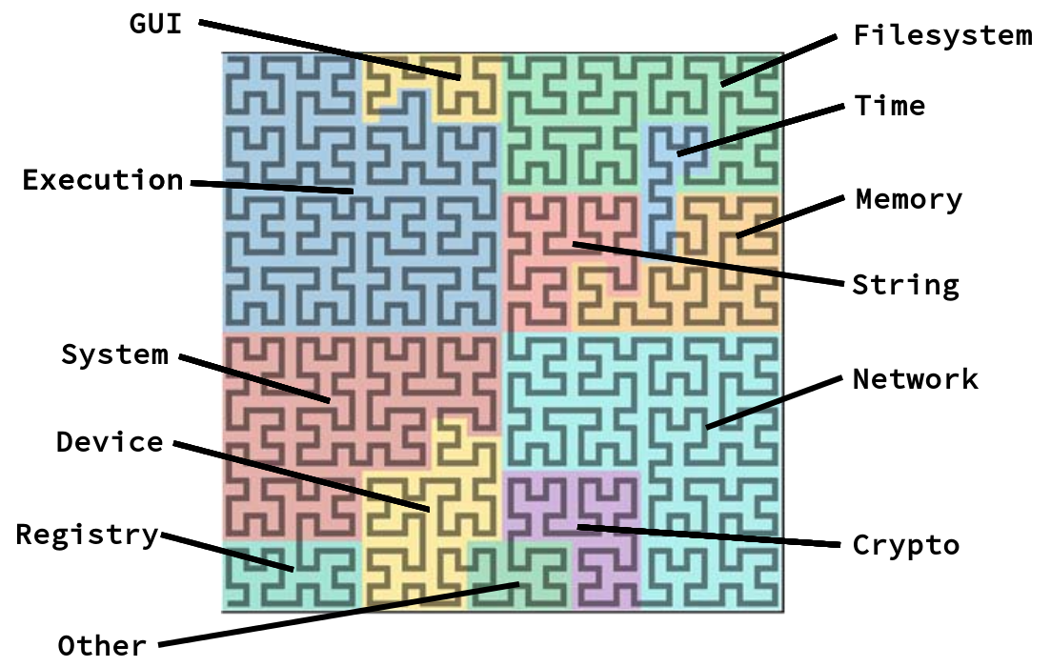
Context-aware Multi-Dimensional Visualization
Use file-format specific context to create Hilbert curves
For PE files, visualize:
Import APIs from IAT
System Calls from behavior report
ByteAtlas: ApiQR representation: Hilbert curve for our 1024 bit ApiVector with the semantic categories
@7h3rAm

Slide 17
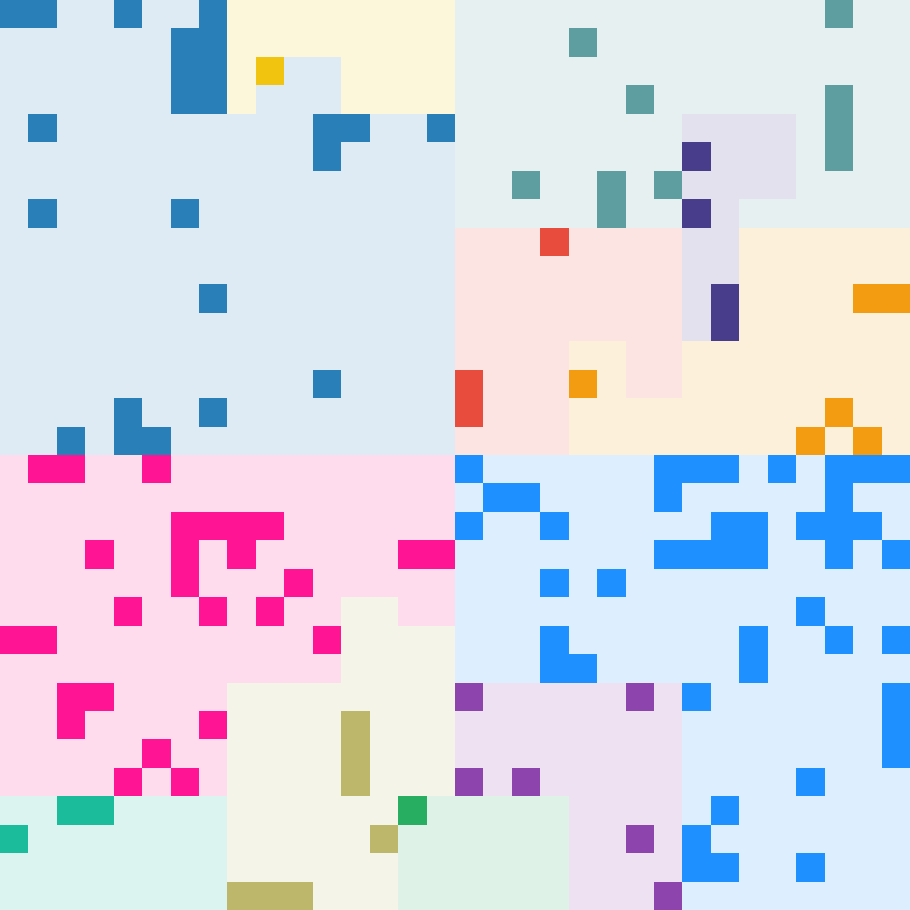
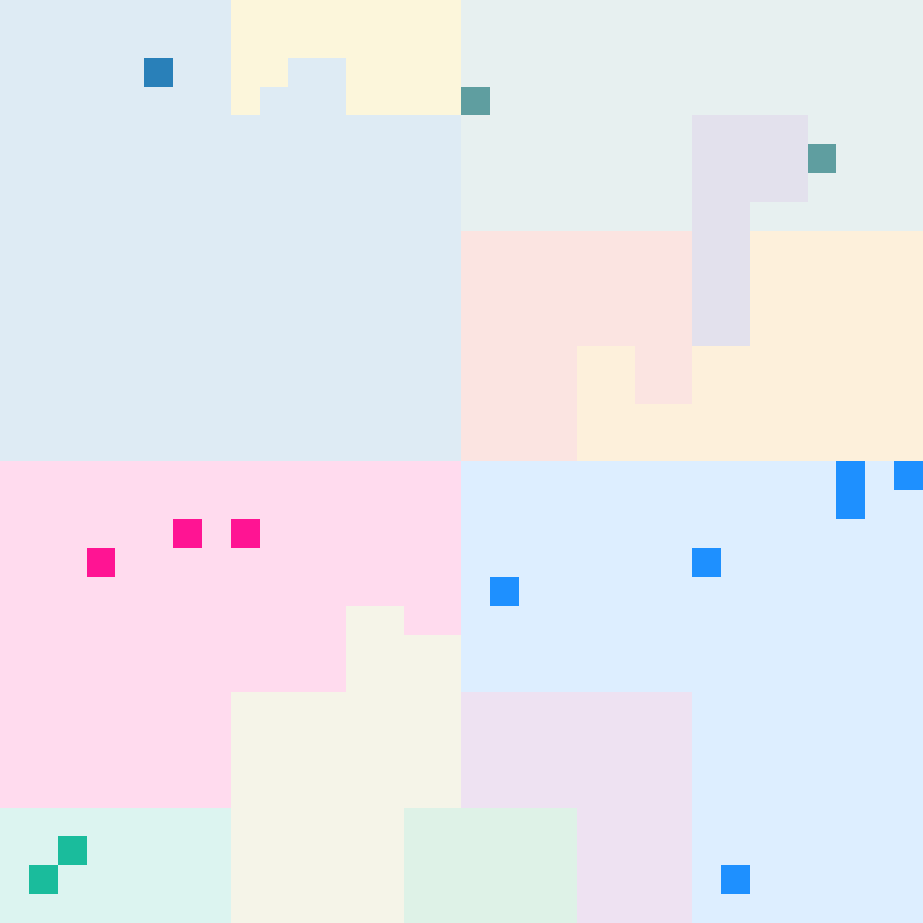
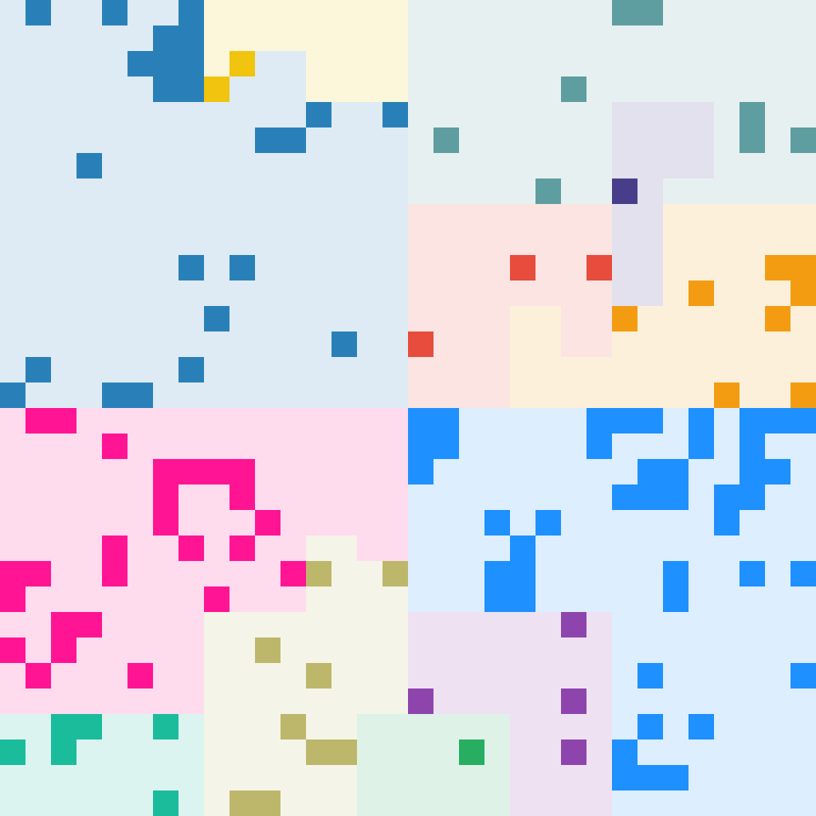
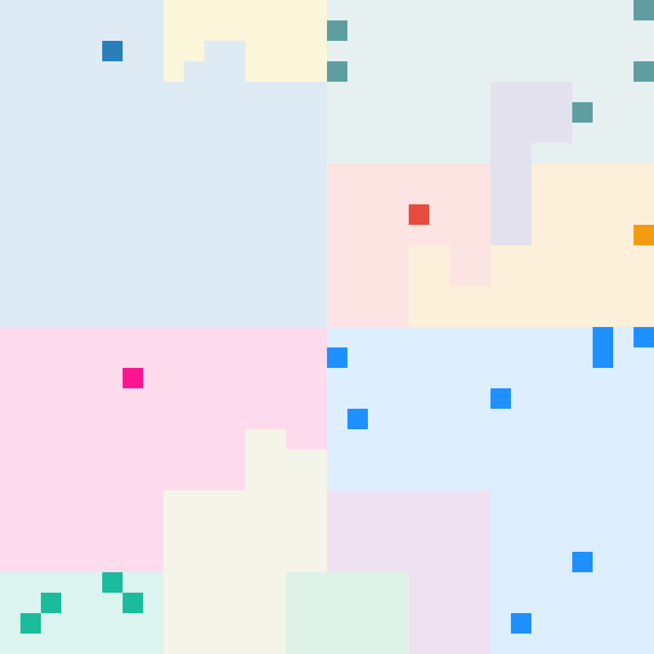
Context-aware Multi-Dimensional Visualization
APIs from IAT and behavior report:
APIs are extracted from IAT and sandbox execution report
Names are normalized (eg: RegOpenKey <- RegOpenKeyExW)
A 32x32 bit vector (1024 cells) is created and mapped on Hilbert curve
A sliding window scheme is used to create animated Hilbert curve from extracted APIs
1
2
3
4
@7h3rAm

Slide 18
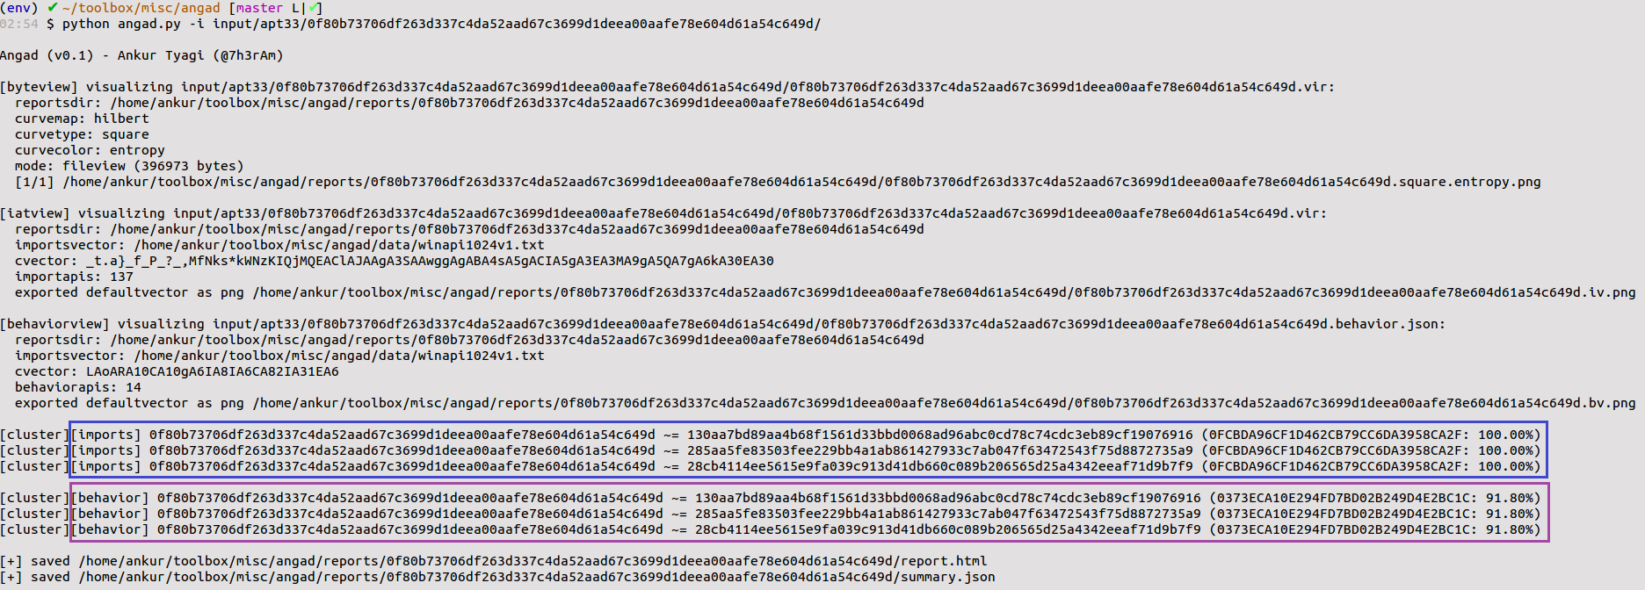
Usecase: #1 APT33
@7h3rAm

Slide 19
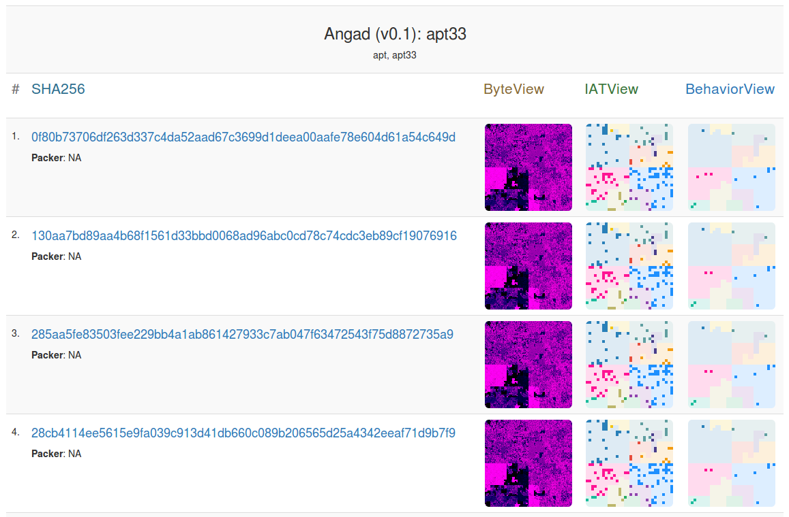
Usecase: #1 APT33
@7h3rAm

Slide 20
Usecase: #2 Dorv
@7h3rAm

Slide 21
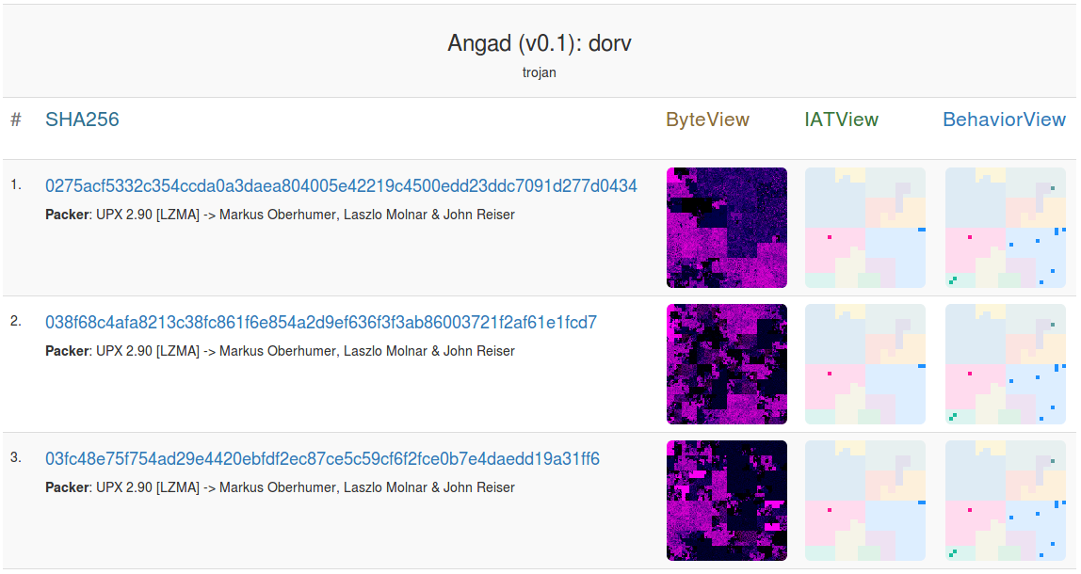
Usecase: #2 Dorv
@7h3rAm

Slide 22
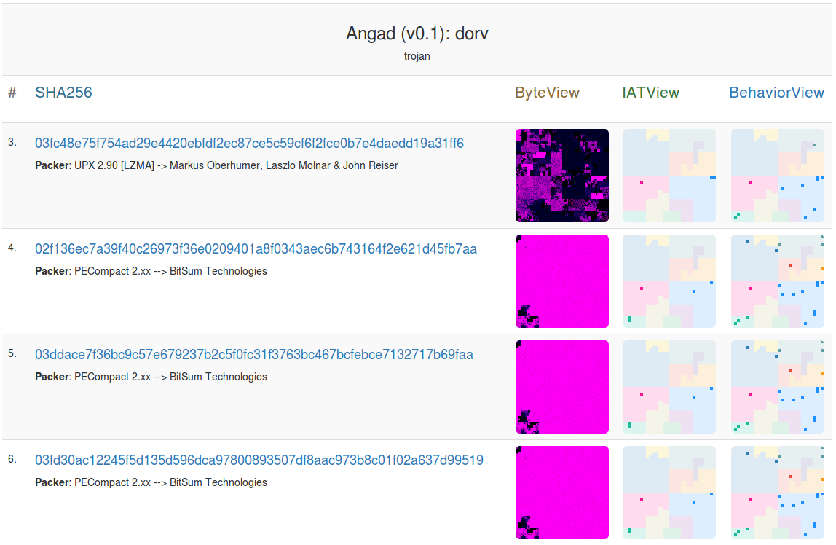
Usecase: #2 Dorv
@7h3rAm

Slide 23
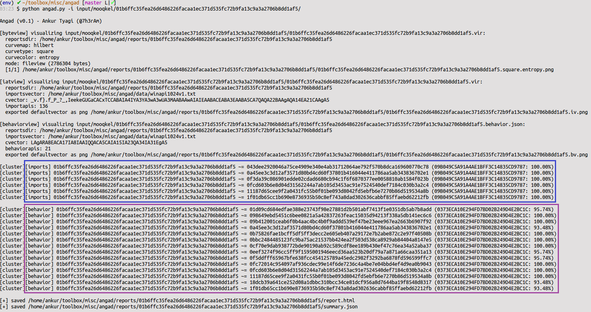
Usecase: #3 Mooqkel
@7h3rAm

Slide 24
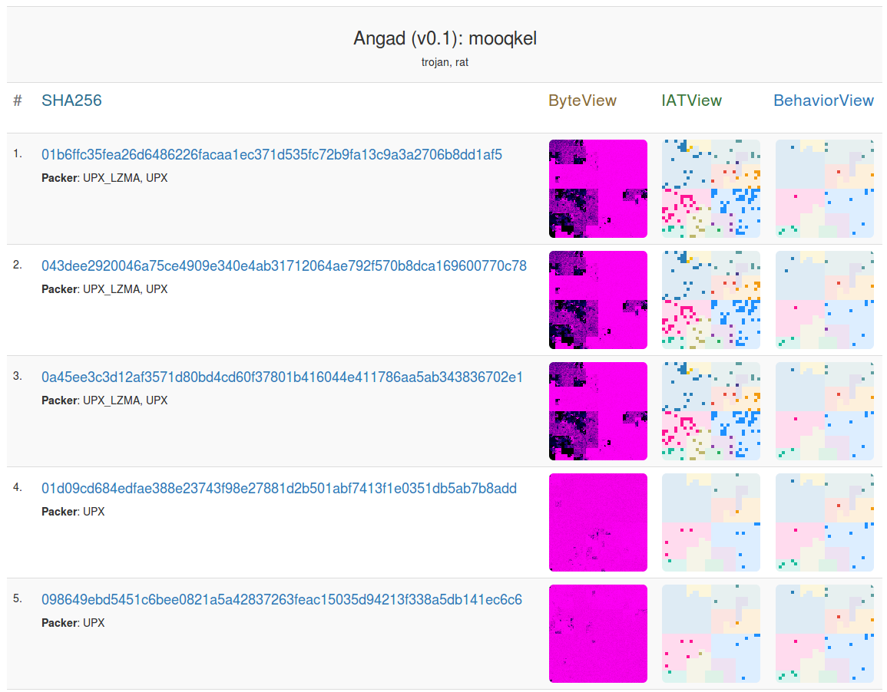
Usecase: #3 Mooqkel
@7h3rAm

Slide 25


Ending Notes / Q&A
https://github.com/7h3rAm/angad/
@7h3rAm
Thanks:
Aldo Cortesi: @cortesi
Daniel Plohmann: @push_pnx
xkcd :)

